Slide 1

ABAP on SAP Business Technology Platform

Slide 2
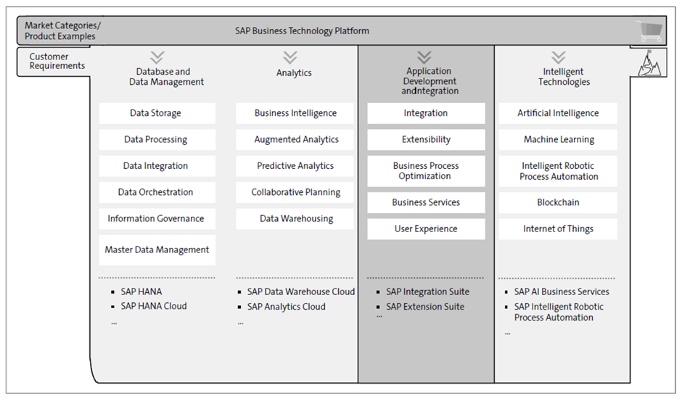
Introduction to SAP Business Technology Platform

Slide 3
SAP Business Technology Platform - Applications
Personalize experiences for SAP applications
Innovate faster with business context
Run on a trusted enterprise-grade platform

Slide 4
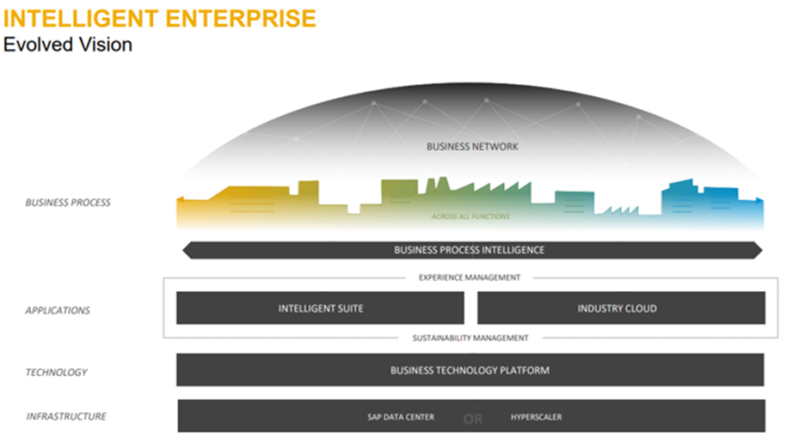

Slide 5
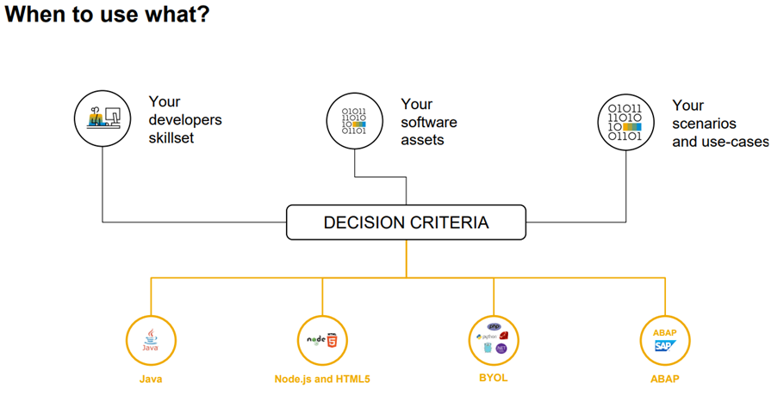

Slide 6
ABAP on SAP Business Technology Platform
SAP BTP ABAP Environment is the SAP Platform-as-a-Service (PaaS) offering for ABAP development that enables developers to leverage their traditional on-premise ABAP know-how to develop and run ABAP applications in the SAP Business Technology Platform, either as extension to SAP software or as standalone applications.

Slide 7
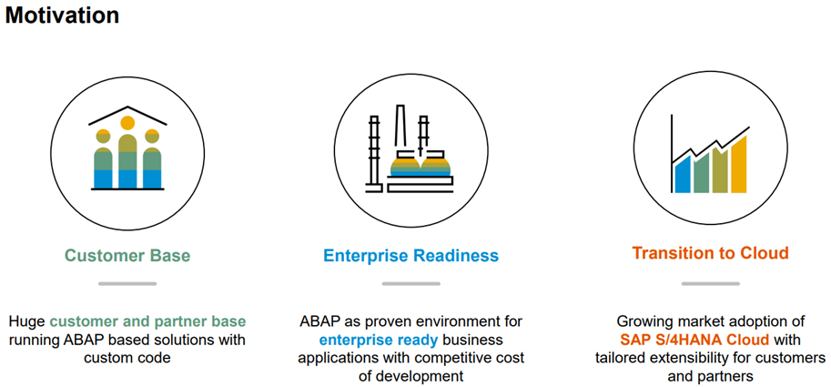

Slide 8
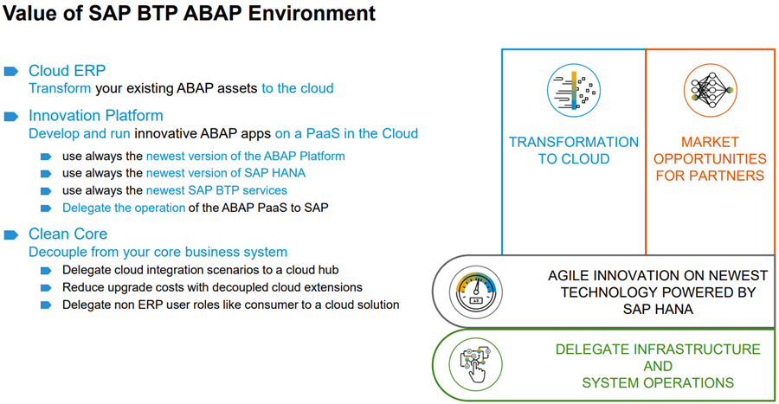

Slide 9
Scenarios of ABAP on SAP BTP
Extension scenario 1: Cloud ERP
Extend SAP S/4HANA Cloud or other SAP cloud offerings with cloud extensions
Use SAP BTP ABAP Environment to extend SAP S/4HANA Cloud or other
SAP cloud solutions SAP Cloud solutions like SAP S/4HANA Cloud provide in-app extensibility to extend SAP apps and processes, but there is no support for classic custom ABAP development on top of SAP S/4HANA Cloud
SAP BTP is the foundation to develop and run custom cloud extensions and the ABAP environment shall be used for ABAP based cloud extensions

Slide 10
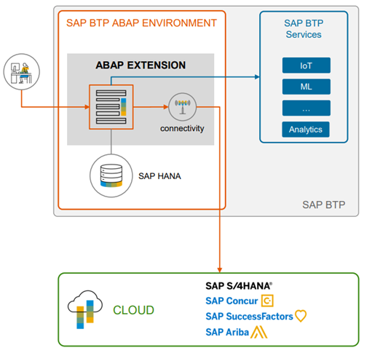

Slide 11
Extension scenario 2: Innovation Platform
Develop and run innovative ABAP apps on a PaaS in the Cloud
Benefit from the newest ABAP Platform and SAP HANA database technologies independent from your existing on-premise system landscape
Build your Fiori apps with the new future proof ABAP RESTful Application Programming Model
Utilize SAP BTP services like IoT, machine learning etc. in your cloud extension
Delegate operation of the ABAP PaaS and new technologies to SAP

Slide 12
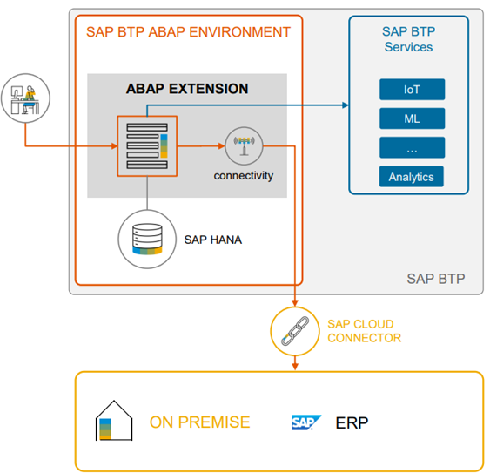

Slide 13
References
https://learning.sap.com/learning-journey/get-started-with-abap-programming-on-sap-btp/understanding-the-basic-features-of-abap_c0e5346f-a136-4b9f-a167-903
https://www.sap.com/documents/2018/08/7a62516c-157d-0010-87a3-c30de2ffd8ff.html
https://open.sap.com/courses/mm4h2

